Slide 1
Model Performance & Tuning

Slide 2
Qualities of a good model
High accuracy scores in unseen data (test / production)\
Generalizable i.e. perform consistently on the test / production data
Within budget constraints
Easy on computation resources both during training and in production
Scalable in production
Easy to implement in production
Easy to explain

Slide 3
Mode Performance Tuning
A step in model building process where we try to drive model performance as many notches up as possible without impacting its generalizability
Metrics used for measuring model performance include R² adjusted R² , Recall, Precision, F1 etc.
When the concerned metrics cross certain threshold we believe the model is meeting performance requirement. This is risky claim. What if it was a “flash in the pan” case?
To asses the model performance more reliably, we use confidence level and confidence interval based approach using Kfold Cross Validation
Train_Test_Not_Reliable.ipynb

Slide 4
Cross Validation

Slide 5
What is cross validation?
Cross-validation is a technique to evaluate / validate a machine learning model and estimate its performance on unseen data
The techniques creates and validates given model multiple times
The number of times it does so, is dependent on the value selected by the user of the technique. Usually expressed as “K” which is always an integer
The sequence of steps used is iterated through as many times as K
The process begins by dividing the original data into K parts / folds using random function

Slide 6
Need for cross validation?
We wish to know how well a ML model is likely to perform in production.
Model’s performance in training is no guarantee for production
To estimate the production score, hold a part of the data out of training phase. This is test data which represents the population/ production
Usually the available data is not sufficient to split into training and test set and expect the two to represent the population well
Hence the model error on test data may not be good estimate of the model error in the population
In the absence of large data sets, a more reliable technique called cross validation can be employed

Slide 7
Need for cross validation?
Car_MPG prediction accuracy trained on 70% and tested on 30%
For each run, we get different accuracy scores
Simple training/test a.k.a validation approach gives varying results with every run (random state not set)
Thus we cannot rely on one round of testing as we would have by chance got the split that gives max score first time
To get a more realistic estimate, we have to use more reliable techniques such as cross validation

Slide 8
Cross validation procedure
Shuffle the dataset randomly
Split the dataset into k folds
For each distinct fold:
Keep the fold data separate / hold out data set
Use the remaining folds as a single training data set
Fit the model on the training set and evaluate it on the test set
Retain the evaluation score and discard the model
Loop back
The steps 3.a to 3.e will be executed K times
Summarize the scores and average it by dividing the sum by K.
Analyze the average score, the dispersion to assess the likely performance of the model in the unseen data (production data / universe)

Slide 9
Implementing K Fold cross validation
Visual understanding (example based on scikitlearn guide)
from numpy import array
from sklearn.model_selection import KFold
data = array([10,20,30,40,50,60,70,80,90,100])
kfold = KFold(5, True)
for train, test in kfold.split(data):
print('train: %s, test: %s' % (data[train], data[test]))
Training Data [ 10 20 30 40 50 60 80 90] | Test Data [70 100]
[ 10 40 50 60 70 80 90 100] | [20 30]
[ 10 20 30 40 50 70 90 100] | [60 80]
[ 10 20 30 50 60 70 80 100] | [40 90]
[ 20 30 40 60 70 80 90 100] | [10 50]
Note : We cannot have K > number of data points…. Why?

Slide 10
Configuring the K
K is an integral number. Minimum value of K has to be 2. There will be two iterations in this case
Max value of K can be the number of data points. This is also known as Leave One Out Cross Validation or LOOCV
Whatever the value of K chosen, the resulting training and test data should be representative of the unseen data as much as possible
There is no formula to decide the K but K = 10 is usually considered good
Too large a K, means less variance across the training sets thus limit the model differences across iterations
For a sample size (N) of n, and K = k, number of records (r) per fold = n/k.

Slide 11
Evaluating the model in an iteration
In each iteration, the model is trained on K -1 number of folds and evaluated on the left out fold.
The MSE or Mean Squared Error is thus calculated on the left out fold
Since the procedure is repeated K times, we will have K MSEs. Total up all the MSE and divide by K to get the overall expected MSE
CVk = 1/k(sum(MSEi) for I = 1 to K

Slide 12
Some salient features of K-fold
Each record / data point in the sample data before creating the Kfolds, is assigned to a single fold and stays in that fold for the duration of the procedure.
This means that each data point is used once in hold-out set and K-1 times in training
Very important point to keep in mind is, any transformation to data such as standardizing or any other data preparation that is required before building the model, must be done in the iteration on the training folds rather than on the entire data set.
When hyper parameters are to be tweaked, split the original data into two. Keep one part aside. Use the other to do the Kfold validation. Once the optimal hyperparameters are found, assess the model on the test data
Any data transformation done on the whole set outside the loop, may lead to data leakage and overfitting

Slide 13
Implementing K Fold cross validation
K fold in Pima Indian Classification
from pandas import read_csv
from sklearn.model_selection import train_test_split
from sklearn.linear_model import LogisticRegression
from sklearn.model_selection import KFold
from sklearn.model_selection import cross_val_score
import numpy as np
filename = 'pima-indians-diabetes.data'
names = ['preg', 'plas', 'pres', 'skin', 'test', 'mass', 'pedi', 'age', 'class']
dataframe = read_csv(filename, names=names)
array = dataframe.values
X = array[:,0:8]
Y = array[:,8]
num_folds = 50
seed = 7
kfold = KFold(n_splits=num_folds, random_state=seed)
model = LogisticRegression()
results = cross_val_score(model, X, Y, cv=kfold)
print(results)
print("Accuracy: %.3f%% (%.3f%%)" % (results.mean()*100.0, results.std()*100.0))

Slide 14
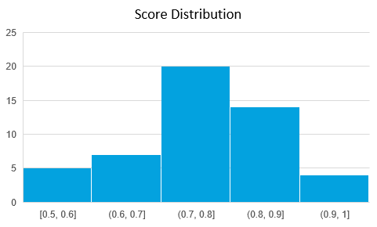
Mean | 0.770166667
Standard Error | 0.015172553
Median | 0.8
Mode | 0.8
Standard Deviation | 0.107286148
Sample Variance | 0.011510317
Kurtosis | 0.2246995
Skewness | -0.267638887
Range | 0.5
Minimum | 0.5
Maximum | 1
Sum | 38.50833335
Count | 50
Confidence Level(95.0%) | 0.030490386
Distribution of the scores on 50 iterations
Model accuracy is likely to be in 0.77 – 0.03 to 0.77 + 0.03 i.e. 0.74 – 0.80 at 95% confidence level

Slide 15
Data leaks
Data leak is the situation where the training set is somehow influenced by the data in the test
As a result, models built on the training data is influenced by data in the test. This is not correct.
A model should never have been influenced by the test data. Test data is representation of production data
Data leaks can happened in the following way -\
Scaling data before splitting into training and testing
Outlier and missing value treatment with central values before splitting
To avoid data leakages, create test data that should be transformed separately and used only of a final check
NNH_BC_Data_Leak.ipynb

Slide 16
Parameters & Hyper Parameters

Slide 17
Parameters and Hyperparameters
There are two types of parameters that influence the performance of a model –
Model Parameters :
They represent the coefficients learnt by an algorithm from the data.
They are fixed after the training is complete
They are used after the model is built
For e.g. weights learnt in a Neural Network or Linear Regression
Hyper Parameters :
used to define the architecture of a model
They are not directly learnt from the data
Have to be fixed before the model is built
For e.g. C, gamma, optimization algorithm etc

Slide 18
Algos | Hyper Parameters
 | Most used | Others | Range | Purpose
Linear Regression | (left blank) | Fit_intercept Normalize Copy_X | T/F T/F T/F | Ignore intercept if Fit_intercept = False Normalize data before fit (will be used only if fit_intercept is True) Copy X before fit
Ridge | Alpha (def = 1) | Solver | As per req Seven options (def = auto) | Severity- degree of penalty. Larger Alpha more constrained the model parameters will be Solver – optimization technique. Includes 'auto', 'svd', 'cholesky', 'lsqr', 'sparse_cg', 'sag', 'saga'
Lasso | Alpha (def = 1) |  |  | Same as above
KNN | n_neighbours (def = 5) | Weights Algorithm | 1 to number of data points. Default Infinity Four options | To fix number of neighbours to consider for classifying a query point To assign weights to the neighbouring points (def = uniform) To choose from 'auto', 'ball_tree', 'kd_tree', 'brute‘. May make training faster
SVC | C (def = 1) Kernel (def = rbf) | gamma degree | As per req Options Infinity infinity | 1.Control the degree of softness in soft margin SVM 2. Nonlinear function to benefit from higher dimensional space 3. Define curvature of the model 4. Degree of polynomial kernel function if used

Slide 19
Algos | Hyper Parameters
 | Most used | Others | Range | Purpose
Decision Tree classifier | 1. max_depth (def = 1) | Criterion max_features max_leaf_nodes min_sample_leaf | 1 to as many Two options “Gini”, “Entropy” 1 – number of features 1 to as many 1 to as many | Number of levels allowed in the DT model Metric to capture information gain Number of features to evaluate to split Number of leaf nodes allowed Define smallest leaf size in terms of number of data points in the leaf
Random Forest | N_estimators (Default = 100) | Criterion Max_depth Max_features bootstrap | Same as above Same as above Same as above Yes /No | Number of instances in the ensemble Metric to capture information gain Number of features to evaluate Whether to use bootstrap sampling
Logistic Regression | C (default = 1) | 2. fit_intercept (Default True) 3.Solver (default = “lbfgs”) | 1. As per req 2. True / False 3. Options include 'newton-cg', 'lbfgs', 'liblinear', 'sag', 'saga' | Penalize large coefficients To remove intercept from the model if required To minimize the error function

Slide 20
Algos | Hyper Parameters
 | Most used | Others | Range | Purpose
Kmeans Clustering | Alpha |  |  | Same as above
Hierarchical Clustering | n_neighbours | Weights Algorithm | 1 to number of data points Infinity Four options | To fix number of neighbours to consider for classifying a query point To assign weights to the neighbouring points To choose from 'auto', 'ball_tree', 'kd_tree', 'brute‘. May make training faster
Deep Learning | C Kernel | gamma degree | Infinity Options Infinity infinity
Note: This is a brief overview of some key hyper parameters of a few algorithms we use. For a complete study of the same pl. visit https://scikit-learn.org/stable/modules/grid_search.html. The differentiation of hyper parameters is empirical. It depends on data distributions

Slide 21
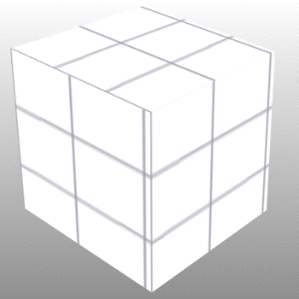
Hyper Parameter Space / Grid
Every valid point in the hyper parameter space represents a model
The Error as a function of the hyper parameters is not convex
There will be many local minima along with a global minima
The challenge is to find the right combination which will take us to the absolute minima
That set of hyper parameters will be the best given the data
We have to validate it using Kfold CV i.e. it should not be a “flash in the pan” case
hp3
hp2
hp1
Hyper parameter space
Decision_Tree_Regressor_Concrete_HyperParameter.ipynb

Slide 22
Hyper Parameters & Tuning
Hyper parameters are like handles available to the modeler to control the behavior of the algorithm used for modeling
Hyper parameters are supplied as arguments to the model algorithms while initializing them. For e.g. setting the criterion for decision tree building “dt_model = DecisionTreeClassifier(criterion = 'entropy’ )”
To get a list of hyper parameters for a given algorithm, call the function get_params()…for e.g. to get support vector classifier hyper parameters
from sklearn.svm import SVC
svcl= SVC()
svc.get_params()
Hyper parameters are not learnt from the data, the data scientist / model builder has to decide what values these should take to create most powerful and yet generalizable model
Ref: Models_HyperParameters.ipynb

Slide 23
Hyper Parameters & Tuning
Fine tuning the hyper parameters is done in a sequence of steps
Selecting the appropriate model type (regressor or classifier such as sklearn.svm.SVC())
Identify the corresponding parameter space
Decide the method for searching or sampling parameter space;
Decide the cross-validation scheme to ensure model will generalize
Decide a score function to use to evaluate the model
Two generic approaches to searching hyper parameter space include
GridSearchCV which exhaustively considers all parameter combinations
RandomizedSearchCV can sample a given number of candidates from a parameter space with a specified distribution.
While tuning hyper parameters, the data should have been split into three parts – Training, validation and testing to prevent data leak (This may not always be possible
The testing data should be separately transformed * using the same functions that were used to transform the rest of the data for model building and hyper parameter tuning
Ref: GridSearchSimpleExample.ipynb
* Any transformation where rows influence each other. For e.g. using zscore. OneHotCode transformation does not come into this category. It can be done before splitting the data

Slide 24
Hyper Parameters & Tuning (GridsearchCV/ RandomizedSearchCv)
GridsearchCV –
Is a basic optimal hyperparameter tuning technique.
It builds a model for each permutation of all of the given hyperparameter values
Each such model is evaluated and ranked.
The combination of hyperparameter values that gives the best performing model is chosen
For every combination, cross validation is used and average score is calculated
This is an exhaustive sampling of the hyperparameter space and can be quite inefficient

Slide 25
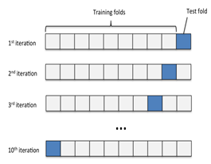
GridSearchCV
One combination of hyper parameters used K times to train and test. The avg score of the K times is the score associated with this combination
This will repeat for all possible combinations i.e. all the cells in the space.
hp3
hp2
hp1
Hyper parameter space
Ref: GridSearchCV_compare_models.ipynb,

Slide 26
Hyper Parameters & Tuning (GridsearchCV/ RandomizedSearchCv)
RandomizedSearchCV –
The motivation to use random search in place of grid search is that for many cases, hyperparameters are not equally important. But which one is and which is not cannot be known apriori
Taking all the hyper parameters with all possible range will make GridsearchCV extremely slow.
RandomsearchCV will randomly pick pre-fixed number of sample points from the hyper parameter space
Each sample point represent a combination of hyper parameter values
For each sample it will use CV to evaluate the respective model
RandomsearchCV has empirically gives better results than GridsearchCV
Give a large range of hyper parameter values to evaluate
Randomly pick pre-fixed number of samples

Slide 27
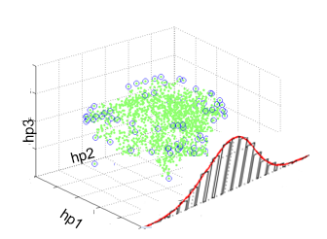
RandomizedSearchCV
Randomly pick up n-iter samples from the hyper parameter distribution as sample, Use it K times and find avg performance
Hyper parameter space
Ref: RandomizedSearchCV_GridSearchCV.ipynb
Use a larger hyper parameter space with randomsearchcv, find the potential combination, use gridsearch in the locality of the optimal combination

Slide 28
Pipelines

Slide 29
What is a pipeline-
Almost always, we need to tie together many different processes that we use to prepare data for machine learning based model
It is paramount that the stage of transformation of data represented by these processes are standardized
Pipeline class of sklearn helps simplify the chaining of the transformation steps and the model
Pipeline, along with the GridsearchCV helps search over the hyperparameter space applicable at each stage

Slide 30
Pipelines
Sequentially apply a list of transforms and a final estimator.
Intermediate steps of the pipeline must be ‘transforms’, that is, they must implement fit and transform methods.
The final estimator only needs to implement fit
Helps standardize the model project by enforcing consistency in building testing and production. Ref: https://scikit-learn.org/stable/modules/compose.html
Building Model
Load Data
Split data
Scale data
Call functions
fit()
Predicting
Load Data
Split data
Scale data
Call functions
predict()
Ref:Pipeline_Simple.ipynb, Pipeline_Gridsearch.ipynb

Slide 31
Build a pipeline
Import the pipeline class
from sklearn.pipeline import Pipeline
Instantiate the class into an object by listing out the transformation steps. In the following example, a scaling function is followed by the SVC algorithm
pipe = Pipeline([(" scaler", MinMaxScaler()), (" lr", logisticregression())])
Call the fit() function on the pipeline object
pipe.fit( X_train, y_train)
Call the score() function on the pipeline object or predict() function
pipe.score( X_test, y_test)
In the step 2b, the pipeline object is created using a dictionary of key:value pairs. The key is specified in strings for e.g. “scaler” followed by the function to be called.
The key is the name given to a step.

Slide 32
Build a pipeline (Contd…)
The pipeline object requires all the stages included to have a “transform()” function except for the last stage which is an estimator.
The transform step transforms the input data. The transformed output of a stage is the input to the next stage
During the call “pipeline.fit()”, the pipeline calls the fit and transform functions on each step in sequence. For the last step, only the fit function is called
While predicting using pipeline, similarly transform function in all the stages followed by a predict function in the last stage is performed
The pipeline object does not need to have a predict function. It only needs to have a fit function at least

Slide 33
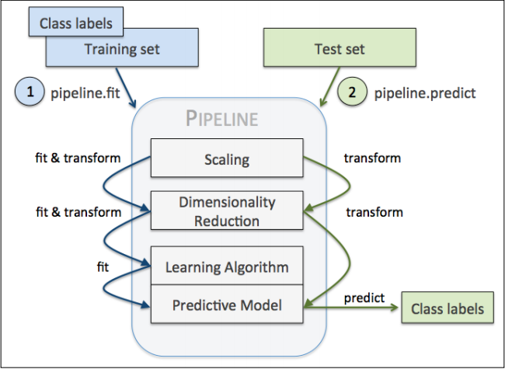
Build a pipeline (Contd…)
Image Source : Python Deeper Insights Into Machine Learning

Slide 34
make_pipeline
Creating the pipeline could be cumbersome. Specifying a name to each stage may not be necessary
Alternatively there is a “make_pipeline()” function that will create the pipeline and automatically name each step. We do not need to specify a name
from sklearn.pipeline import make_pipeline
pipe = make_pipeline( MinMaxScaler(), (SVC()))
print(" Pipeline steps:\ n{}". format( pipe.steps))
Note, we have not specified any name to the stages. The names will be automatically assigned and are usually lowercase of the class names
Pipeline_detail.ipynb

Slide 35
make_pipeline
Download Wisconsin Breast Cancer dataset from UCI
Create dataframe
Split into X and y
Transform y into numerical using labelencoder
Split data into training testing
Standardize dataset using standard scalar
Use PCA to reduce to 2 dimensions
Use logistic regression on the reduced dimensions
Create a pipeline
Do a fit and score
Pipeline_GridSearchcv_wisc_bc_data_classwork.ipynb

Slide 36
Linear Regression Hyperparameters

Slide 37
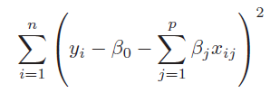
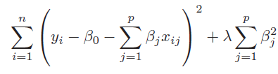
Regularising Linear Models (Shrinkage methods)
When we have too many parameters and exposed to curse of dimensionality, we resort to dimensionality reduction techniques such as transforming to PCA and eliminating the PCA with least magnitude of eigen values. This can be a laborious process before we find the right number principal components. Instead, we can employ the shrinkage methods.
Shrinkage methods attempt to shrink the coefficients of the attributes and lead us towards simpler yet effective models. The two shrinkage methods are :
Ridge regression is similar to the linear regression where the objective is to find the best fit surface. The difference is in the way the best coefficients are found. Unlike linear regression where the optimization function is SSE, here it is slightly different
The term 𝝺 is like a penalty term used to penalize large magnitude coefficients when it is set to a high number, coefficients are suppressed significantly. When it is set to 0, the cost function becomes same as linear regression cost function
Linear Regression cost function
Ridge Regression with additional term in the cost function

Slide 38
Regularising Linear Models (Shrinkage methods)
Why should we be interested in shrinking the coefficients? How does it help?
When we have large number of dimensions and few data points, the models are likely to become complex, overfit and prone to variance errors. When you print out the coefficients of the attributes of such complex model, you will notice that the magnitude of the different coefficients become large
Large coefficients indicate a case where for a unit change in the input variable, the magnitude of change in the target column is very large.
Coeff for simple linear regression model of 10 dimensions
Coeff with polynomial features shooting up to 57 from 10
-9.67853872e-13 -1.06672046e+12 -4.45865268e+00 -2.24519565e+00 -2.96922206e+00 -1.56882955e+00 3.00019063e+00 -1.42031640e+12 -5.46189566e+11 3.62350196e+12 -2.88818173e+12 -1.16772461e+00 -1.43814087e+00 -7.49492645e-03 2.59439087e+00 -1.92409515e+00 -3.41759793e+12 -6.27534905e+12 -2.44065576e+12 -2.32961194e+12 3.97766113e-01 1.94046021e-01 -4.26086426e-01 3.58203125e+00 -2.05296326e+00 -7.51019934e+11 -6.18967069e+11 -5.90805593e+11 2.47863770e-01 -6.68518066e-01 -1.92150879e+00 -7.37030029e-01 -1.01183732e+11 -8.33924574e+10 -7.95983063e+10 -1.70394897e-01 5.25512695e-01 -3.33097839e+00 1.56301740e+12 1.28818991e+12 1.22958044e+12 5.80200195e-01 1.55352783e+00 3.64527008e+11 3.00431724e+11 2.86762821e+11 3.97644043e-01 8.58604718e+10 7.07635073e+10 6.75439422e+10 -7.25449332e+11 1.00689540e+12 9.61084146e+11 2.18532428e+11 -4.81675252e+12 2.63818648e+12
The coefficient for cyl is 2.5059518049385052
The coefficient for disp is 2.5357082860560483
The coefficient for hp is -1.7889335736325294
The coefficient for wt is -5.551819873098725
The coefficient for acc is 0.11485734803440854
The coefficient for yr is 2.931846548211609
The coefficient for car_type is 2.977869737601944
The coefficient for origin_america is -0.5832955290166003
The coefficient for origin_asia is 0.3474931380432235
The coefficient for origin_europe is 0.3774164680868855
Ref: Ridge_Lasso_Regression.ipynb
Very large coefficients!

Slide 39
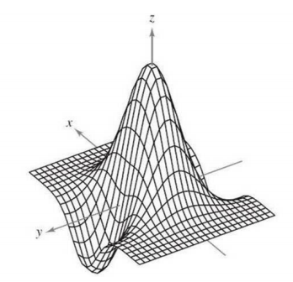
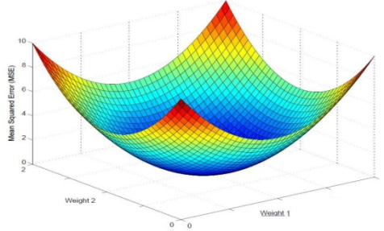
Regularising Linear Models (Shrinkage methods)
Z = f ( x, y)
Curse of dimensionality results in large magnitude coefficients which results in a complex undulated surface / model.
This complex surface has the data points occupying the peaks and the valleys
The model gives near 100% accuracy in training but poor result in testing and the testing scores also vary a lot from one sample to another.
The model is supposed to have absorbed the noise in the data distribution!
Large magnitudes of the coefficient give the least SSE and at times SSE = 0! A model that fits the training set 100%!
Such models do not generalize
= 0

Slide 40
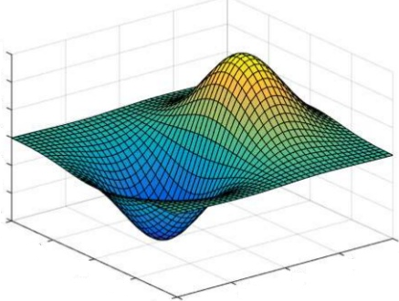
Regularising Linear Models (Shrinkage methods)
In Ridge Regression, the algorithm while trying to find the best combination of coefficients which minimize the SSE on the training data, is constrained by the penalty term
The penalty term is akin to cost of magnitude of the coefficients. Higher the magnitude, more the cost. Thus to minimize the cost, the coefficient are suppressed
Thus the resulting surface tends to be relatively much more smoother than the unconstrained surface. This means we have settled for a model which will make errors in the training data
This is fine as long as the errors can be attributed to the random fluctuations i.e. because the model does not absorb the random fluctuations in the data
Such model will perform equally well on unseen data i.e. test data. The model will generalize better than the complex model
Z = f ( x, y)

Slide 41
Regularising Linear Models (Shrinkage methods)
Impact of Ridge Regression on the coefficients of the 56 attributes
Ridge model: [[ 0. 3.73512981 -2.93500874 -2.13974194 -3.56547812 -1.28898893 3.01290805
2.04739082 0.0786974 0.21972225 -0.3302341 -1.46231096 -1.17221896 0.00856067 2.48054694
-1.67596093 0.99537516 -2.29024279 4.7699338 -2.08598898 0.34009408 0.35024058 -0.41761834
3.06970569 -2.21649433 1.86339518 -2.62934278 0.38596397 0.12088534 -0.53440382 -1.88265835
-0.7675926 -0.90146842 0.52416091 0.59678246 -0.26349448 0.5827378 -3.02842915 -0.36548074
0.5956112 -0.15941014 0.49168856 1.45652375 -0.43819158 -0.20964198 0.77665496 0.36489921
-0.4750838 0.3551047 0.23188557 -1.42941282 2.06831543 -0.34986402 -0.32320394 0.39054656 0.06283411]]
Large coefficients have been suppressed, almost close to 0 in many cases.
Ref: Ridge_Lasso_Regression.ipynb

Slide 42
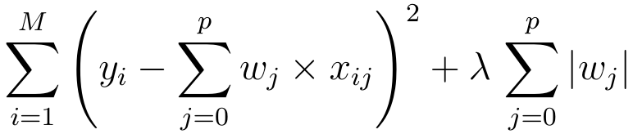
Regularising Linear Models (Shrinkage methods)
Lasso Regression is similar to the Ridge regression with a difference in the penalty term. Unlike Ridge, the penalty term here is raised to power 1. Also known as L1 norm.
The term continues to be the input parameter which will decide how high penalties would be for the coefficients. Larger the value more diminished the coefficients will be.
Unlike Ridge regression, where the coefficients are driven towards zero but may not become zero, Lasso Regression penalty process will make many of the coefficients 0. In other words, literally drop the dimensions

Slide 43
Regularising Linear Models (Shrinkage methods)
Impact of Lasso Regression on the coefficients of the 56 attributes
Lasso model: [ 0. 0.52263805 -0.5402102 -1.99423315 -4.55360385 -0.85285179 2.99044036 0.00711821 -0. 0.76073274 -0. -0. -0.19736449
0. 2.04221833 -1.00014513 0. -0. 4.28412669 -0. 0. 0.31442062 -0. 2.13894094 -1.06760107 0. -0. 0. 0. -0.44991392 -1.55885506 -0. -0.68837902 0.
0.17455864 -0.34653644 0.3313704 -2.84931966 0. -0.34340563 0.00815105 0.47019445 1.25759712 -0.69634581 0. 0.55528147 0.2948979 -0.67289549
0.06490671 0. -1.19639935 1.06711702 0. -0.88034391 0. -0. ]
Large coefficients have been suppressed, to 0 in many cases, making those dimensions useless i.e. dropped from the model.
Ref: Ridge_Lasso_Regression.ipynb

Slide 44
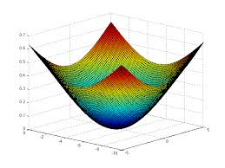
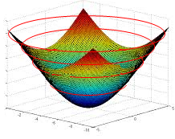
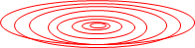
Regularising Linear Models (Comparing The Methods)
To compare the Ridge and Lasso, let us first transform our error function (which is a quadratic / convex function) into a contour graph
Every ring on the error function represents a combination of coefficients (m1 and m2 in the image) which result in same quantum of error i.e. SSE
Let us convert that to a 2d contour plot. In the contour plot, every ring represents one quantum of error.
The innermost ring / bull’s eye is the combination of the coefficients that gives the lease SSE
m2
m1

Slide 45
Regularising Linear Models (Ridge Constraint)
Most optimal combination of m1, m2 given the constraints
Yellow circle is the Ridge constraint region representing the ridge penalty (sum of squared coeff)
Any combination of m1 nd m2 that fall within yellow is a possible solution
The most optimal of all solutions is the one which satisfies the constraint and also minimizes the SSE (smallest possible red circle)
Thus the optimal solution of m1 and m2 is the one where the yellow circle touches a red circle.
Lowest SSE error ring. violates the constraint
m2
Sub-optimal combination of m1, m2. Meets constraint but is not the minimal possible SSE within constraint
Allowed combination of m1, m2 by Ridge Constraints
m1
The point to note is that the red rings and yellow circle will never be tangential (touch) on the axes representing the coefficient. Hence Ridge can make coefficients close to zero but never zero. You may notice some coefficients becoming zero but that will be due to roundoff…

Slide 46
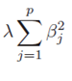
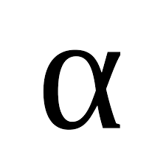
Regularising Linear Models (Ridge Constraint)
As the lambda value (shown here as alpha) increases, the coefficients have to become smaller and smaller to minimize the penalty term in the cost function i.e. the
The larger the lambda, smaller the sum of squared coefficients should be and as a result the tighter the constraint region
The tighter the constraint region, the larger will be the red circle in the contour diagram that will be tangent to the boundary of the yellow region
Thus, higher the lambda, stronger the shrinkage, the coefficients are shrinked strongly and hence more smooth the surface / model
More smoother the surface, more likely the model is going to perform equally well in production
When we move away from a model with sharp peaks and valleys (complex model) to smoother surface (simpler models), we reduce the variance errors but bias errors go up.
Using gridsearch, we have to find the right value of lambda which results in right fit, neither too complex nor too simple a model
m2
m1

Slide 47
Regularising Linear Models (Lasso Constraint)
Most optimal combination of m1, m2 given the constraints
Yellow rectangle is the Lasso constraint region representing the Lasso penalty (sum coeff)
Any combination of m1 nd m2 that fall within yellow is a possible solution
The most optimal of all solutions is the one which satisfies the constraint and also minimizes the SSE (smallest possible red circle)
Thus the optimal solution of m1 and m2 is the one where the yellow rectangle touches a red circle.
Lowest SSE error ring. violates the constraint
m2
Sub-optimal combination of m1, m2. Meets constraint but is not the minimal possible SSE within constraint
Allowed combination of m1, m2 by Lasso Constraints
m1
The beauty of Lasso is, the red circle may touch the constraint region on the attribute axis! In the picture above the circle is touching the yellow rectangle on the m1 axis. But at that point m2 coefficient is 0! Which means, that dimension has been dropped from analysis. Thus Lasso does dimensionality reduction which Ridge does not

Slide 48
Performance Evaluation

Slide 49
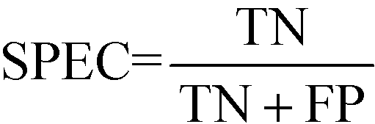
Model performance measures
Confusion Matrix – A 2X2 tabular structure reflecting the performance of the model in four blocks
Accuracy – How accurately / cleanly does the model classify the data points. Lesser the false predictions, more the accuracy
Sensitivity / Recall – How many of the actual True data points are identified as True data points by the model . Remember, False Negatives are those data points which should have been identified as True.
Specificity – How many of the actual Negative data points are identified as negative by the model
Precision – Among the points identified as Positive by the model, how many are really Positive
Confusion Matrix | Predicted Positive | Predicted Negative
Actual Positive | True Positive | False Negative
Actual Negative | False Positive | True Negative
Ref: http://localhost:8888/notebooks/FMTS/classification_metrics-1.ipynb
http://localhost:8888/notebooks/FMTS/ROC_AUC.ipynb

Slide 50
Model performance measures
Assume model is identifying defaulters. In this binary classification defaulter class is class of interest and labeled as +ive (positive - 1) class, other class is –ve(negative - 0)
True Positives - cases where the actual class of the data point and the predicted is same. For e.g. a defaulter (1) predicted as defaulter (1)
True Negatives – cases where the actual class was non-defaulter and the prediction also was non-defaulter
False Positives – cases where actual class was negative (0) but predicted as defaulter (1)
False Negatives – cases where the actual class was positive (1) but predicted as non-defaulter (0)
Ideal scenario will be when all positives are predicted as positives and all negatives are predicted as negatives

Slide 51
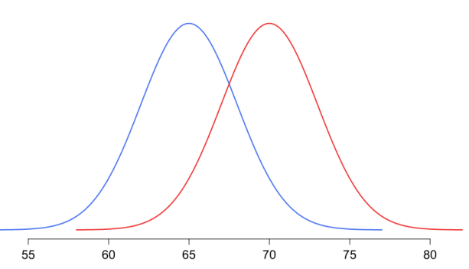
Model performance measures
In practical world this will never be the case. There will be some false positives and false negatives
Our objective will be to minimize both but the problem is, when we minimize one the other will increase and vice versa!
The problem is in the overlap region in the distributions
Objective will be to minimize one of the error types, either the false positive or false negative
Threshold
Non-default
Default
Problem region
Attribute x

Slide 52
Model performance measures
Minimize false negatives - if predicting a positive case as negative is going to be more detrimental for e.g. predicting a cancer patient (positive) as non-cancer (negative)
Minimize false positives – if predicting a negative as positive is going to be more detrimental for e.g. predicting a boss’s mail as spam!
Accuracy – over all correct predictions from all the classes to total number of cases. Should rely on this metrics only when all classes are equally represented. Not reliable if class representation is lopsided as algorithms are biased towards over represented class
Precision - TP/ TP+ FP. When we focus on minimizing false negatives, TP will increase but along with it FP will also increase. How much increase in TP starts hurting (due to increase in FP) ?

Slide 53
Model performance measures
Recall – TP / TP + FN : when we reduce FN to increase TP, how much we gain ? Recall and precision will oppose each other. We want recall to be as close to 1 as possible without precision being too bad
To compare models, we use ROC AUC that gives us the optimal combination of these metrics

Slide 54
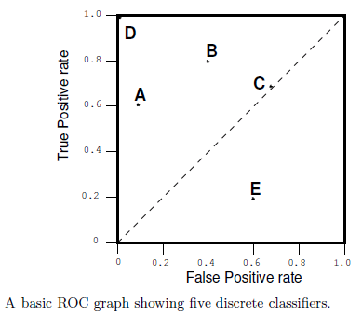
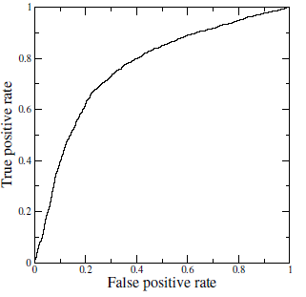
Receiver Operating Characteristics (ROC) Curve
A technique for visualizing classifier performance
It is a graph between TP rate and FP rates
TP rate = TP / total positive
FP rate = FP / total negative
ROC graph is a trade off between benefits (TP) and costs (FP)
The point (0,1) represents perfect classified (e.g. D)
TP = 1 and FP = 0
Classifiers very close to Y axis and lower (nearer to x axis) are conservative models and strict in classifying positives (low TP rate)
Classifiers on top right are liberal in classifying positives hence higher TP rate and FP rate
Ref:ROC_AUC.ipynb , ROC_Threshold_Management.ipynb

Slide 55
Accuracy & Generalizability

Slide 56
Highly Accurate & Generalizable Model
Models generalize well when they are neither overfit nor underfit
Right fit models are the ones which have minimal bias and variance errors
How does one know whether the current version of a model has the minimal bias variance error?
Measure the accuracy of the model both for training and testing data simultaneously
Depending on a single test set is not reliable method to judge the quality of a model
Since we do not have multiple test sets, we use K-fold cross validation and / or Boot Strap sampling to mimic multiple test sets

Slide 57
Modelling Errors
All models are impacted by three types of errors which reduce their predicting power.
Bias error
Variance errors
Random errors
Bias errors
Caused by the decisions taken at the various stages of modelling starting from data collection / sampling stage
Choice of attributes based on the analysis of the data available
Choice of the complexity of the model based on observations in the data
Splitting the data into training validation and testing
Class size. Algorithms have a bias towards higher represented class for overall accuracy
Variance errors (Known variance)
Variance in the behaviour of the model
The model based on a sample will perform differently on different samples
Variance errors increase with increase in number of attributes in the model due to increase in degrees of freedom for the data points to wriggle in
Random errors (unknown variance)
Caused by unknown factors. They cannot be modelled

Slide 58
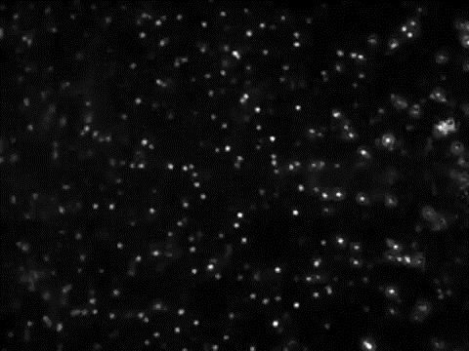
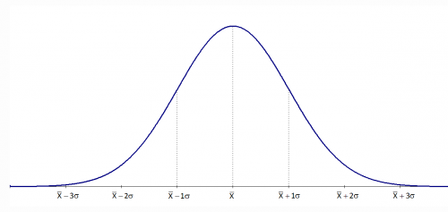
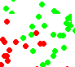

Modelling Errors – Variance error
Universe / Population
Time T1
Time T2
Sample / snapshot

Slide 59
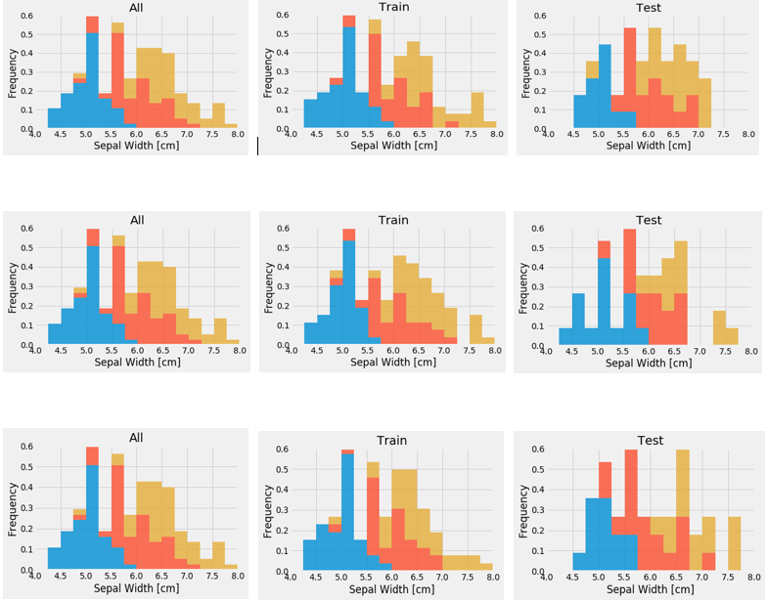
Modelling Errors Visaual demo of variance in training and test data
Sample Data (Analytics Base Table)
Three Random Training Sets From ABT
Three Random Test Sets From ABT

Slide 60
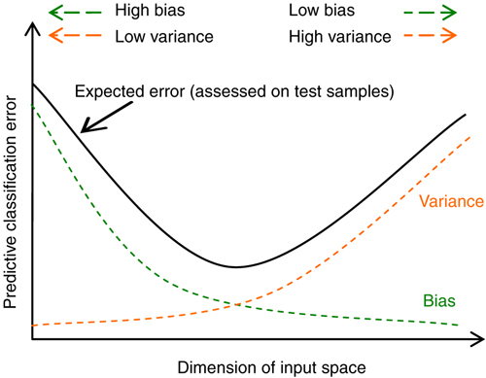
Modelling Errors
We have to find the right attributes and the right number of dimensions such that the total effect of these two (indicated by black curve) minimizes.
The gap between variance curve and total error curve reflects presence of random errors in the model

Slide 61
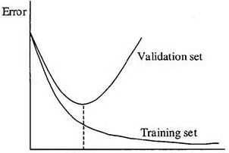
Modelling Errors
As we move from left to right, we move away from underfit to overfit model
In the underfit case, both the training and validation errors are high
In overfit case, the training set error continues to minimize i.e. training accuracy goes very high (not shown), while the validation error increases i.e validation accuracy drops much below training accuracy

Slide 62
Fitness of a Model
Right fit / Generalize
Models are expected to perform well (meet least accuracy thresholds) in production (real world data)
But data in real world is under flux / jiggle
Models have to perform in this context of continuous jiggle. Such models are said to generalize well
For models to generalize well, they should neither be underfit or overfit in the training data
Underfit models
Models that are over simplified i.e. models in which the independent and dependent attributes interact in a simple linear way ( can be expressed in a linear form for e.g. y = mx + c).
The model could have been addressed as a quadratic form such as y = m1x + m2 x^2 +C
Underfit models result in errors as they fail to capture the complex interactions among the attributes in the real world
These models will not generalize in the real world
Overfit models
Models that perform very well (sometimes with zero errors) in training data
Are complex polynomial surfaces that twist and turn in the feature space to cleanly separate the classes
Adjust to the variance in the training data i.e. try to adjust to the positions of the data points though those positions are not the expected values of the data points (mean of the jiggle)
These models adapt to the variance error in the data set and will not generalize in the real world

Slide 63
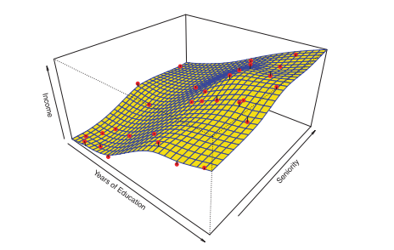
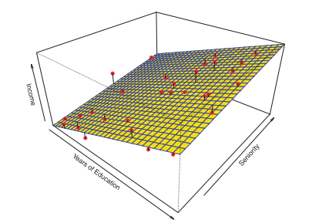
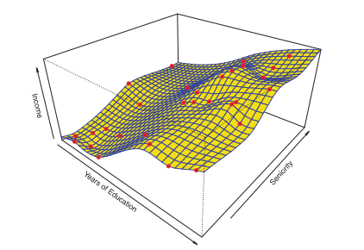
Fitness of a Model
Good fit
Over fit
Underfit
In overfit models, the models absorb the noise (variance) in the data points achieving almost 100% accuracy in controlled environment. But when used in production (where the data points have different variance, the models will perform poorly

Slide 64
Sampling and its effects

Slide 65
It all begins with sampling…. So do bias and variance errors
For a sample to be close representative of the population we need the right attributes, right size, correct class representation
A sample being subset of the population can fall short of these requirements. As a result, it represents subset of the patterns, also have unexplained patterns that get clubbed as residuals
Problem becomes acute when we are in classification and the data is imbalanced in terms of representing the classes.

Slide 66
Sample Data (Analytics Base Table)
Three Random Training Sets From ABT
Three Random Test Sets From ABT

Slide 67
Imbalanced datasets impact outcome of ML models negatively when the class of importance is under represented
The ML algorithms such as decision trees, logistic regressions are designed to reduce overall inaccuracies and hence get biased towards over represented class
When class of importance is under represented, no amount of tuning the models will help
Suppose we have 1000 records of which 20 are fraudulent cases and 980 normal cases. We have to predict fraudulent cases accurately. The event rate is only 2%. Conventional classifiers tend to perform higher Type II errors (fraudulent cases identified as normal)

Slide 68
ThankYou

